Slide 1

Welcome
Leaders/Instructors
Kim, Police
Terry, Police
Erin, Rec and Parks North Memorial Paramedics Brooklyn Park Fire Department
Notes:
This is the generic title page. Use this only when you don’t have an appropriate large photo for option 1.

Slide 2
Home Alone Today’s Topics
Getting organized for morning alone time
Getting home safely after school
How to be safe at home
What to do when someone calls/comes to the door
How to call 911 in case of an emergency
Basic first aid and choking skills
Fire safety, escape plans & severe weather safety
Having fun alone and keeping busy
Handling sibling arguments
Kitchen safety and healthy snacks

Slide 3
Getting Organized for Mornings
Begin each morning the night before. Pack book bags, lay out clothes, prepare lunches and review assignments due the next day so that you have little to worry about in the morning.
Set a clock, watch or cell phone alarm to remind you when to leave for the bus stop or school.
Lock the door behind you.

Slide 4
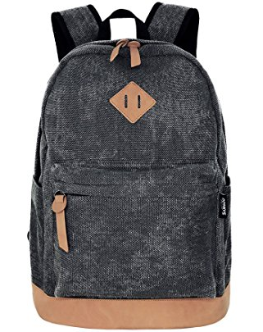
What do you need for school?

Slide 5


How do you wake up in the morning?

Slide 6
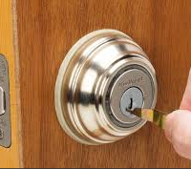
Last thing we do before we leave…
LOCK UP!

Slide 7

Getting Home Safely After School
Whether you bus, carpool, bike or walk, make sure your parents know your route.
If you walk or bike, remember to follow traffic safety rules.
Have a back up plan for bad weather (carry emergency numbers with you).
Never accept rides from people you and your family don’t know well.

Slide 8
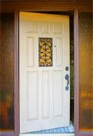
Safe at Home
Look first. As you approach your home, does everything look normal? Don’t go in if you see an open door or window, a stranger or an unfamiliar vehicle nearby.
Stay calm *** take a deep breath
Go to the neighbors and call a
parent or 911.

Slide 9
The KEY to Safety
If everything looks normal, use your key (or code) to enter.
Lock the door immediately.
Always check-in with your parents (phone/text).
Forget Your Key?
Don’t panic
If your parents gave an extra key to the neighbors, get the key from them.
If the neighbors aren’t home, follow the plan set up with your parents to reach another contact person.

Slide 10
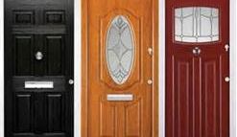
Safe at Home
While home alone, strangers may come to the door. NEVER open the door.
The best policy is for children NOT to answer the door when adults are not home.
Don’t open the door to accept deliveries.
A package may be left outside or delivered later.

Slide 11

Phone Tips
The phone is an awesome tool.
Answer calls from your parents or people you know, consider not answering unknown calls
NEVER tell a caller you are home alone.
Offer to take a message because “my parents can’t come to the phone right now.”
Be polite, but firm.

Slide 12
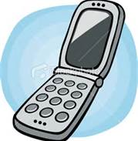
Phone Tips
If someone gets nasty or says inappropriate things, hang up immediately; tell your parents when they get home.
If a caller continues to bother you or threaten you, call your parents immediately, or call 911.

Slide 13
What if…
You get a call from a number you do not recognize?

Slide 14

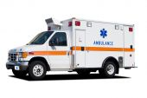

Dial 9-1-1 For Help
Police
Fire
Medical

Slide 15
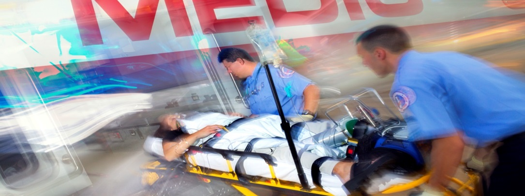
When to call 9-1-1
Accidents/Medical

Slide 16
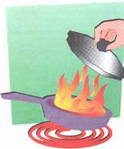
When to Call 9-1-1
Fire

Slide 17
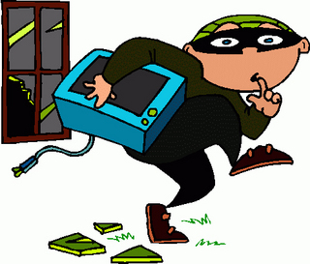
When to Call 9-1-1
Crime

Slide 18


When to Call 9-1-1
Suspicious Activity

Slide 19
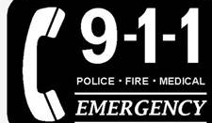
If you Call 9-1-1
Be Ready to Give:
Your full name
Your address (where you are)
A description of the problem – don’t hang up the phone until the dispatcher tells you it’s okay.

Slide 20
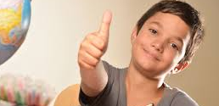
Everyone write down:
One thing you can do to make your morning easier.

Slide 21

Questions?
Notes:
You don’t need to use this slide.

Slide 22





brooklynpark.org
/brooklynparkmn
/user/brooklynparkmn
@brooklynpark
Notes:
You don’t need to use this slide.

