Slide 1
Rules, Activities & Siblings
Erin
Brooklyn Park Recreation & Parks Department

Slide 2

Staying Safe
Who is a safe adult to talk to in your neighborhood
Phone numbers
Who to call if…..
What to do if…..
What is your number, address & location (landmark)
Where do your mom & dad work (phone numbers)
Another emergency contact

Slide 3

Sample Schedule
3:30 PM - Arrive Home
3:45 PM – Check in
4:00 PM - Have an approved snack
4:30 PM - Chores and/or Homework
5:15 PM - Free Time
6:00 PM - Mom and/or Dad Home
Why?? Benefits??

Slide 4

Ground Rules
Post the Rules where everyone can see them.
Communication
TV, movies, computer games
Homework
Friends
Outside
Foods
Activities
Appliances
Chores
Schedule

Slide 5
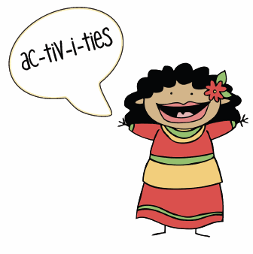
Activities
Read a book or magazine
Work on a hobby or try a new one
Listen to music, practice your instrument
Phone a friend, Skype
Color, draw, write, paint
Snacks
Take a nap
Siblings
Cell phone, internet, TV, video games

Slide 6

Weeknights/Weekends
Should be at least 12-13, but decision based on parents judgement.
How do you feel? Anxiety?
Handle serious or stressful situations?
Activities happening?
Where will parents be?
When will they be home?

Slide 7
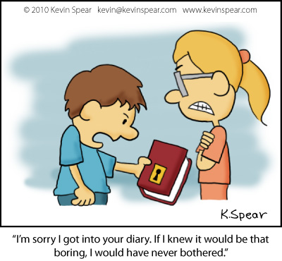

Siblings
Sibling rivalry-what is it
What about your family?
Home Alone with siblings
Why are you fighting? - tired, hungry, frustrated, annoyed?
Compromise possible?
Under 6 – siblings not developmentally able to reason-diversion tactic
Good role model
Ask, don’t tell
Competition
Settle without tattling
Walking away

Slide 8

Questions?

