Slide 1
Kitchen and Fire Safety Terry, Police Dept.
Notes:
This is the generic title page. Use this only when you don’t have an appropriate large photo for option 1.

Slide 2
Kitchen Fire Safety

Slide 3
Kitchen Fire Safety
Cooking is the number one cause of fires and fire related deaths and injuries in the United States. Since you are at the age where you cook more for yourself, it is important to learn about fire safety in your kitchen.

Slide 4
What Are Some of The Dangers in the Kitchen?

Slide 5

Flame or Hot Burner

Slide 6
Scald

Slide 7
Electrical

Slide 8
Cuts
Knives
Peelers / Graters
Blades on Appliances

Slide 9
Chemical

Slide 10
Rules of the Kitchen
With your parents, determine what the rules are in your kitchen.
Are you allowed to use the microwave, toaster, blender?
How about the oven and stove?
What type of foods/snacks are you allowed to make?
Does the kitchen need to be cleaned up before your parent(s) get home?

Slide 11
Practice w/ Your Parents or Grandparents
Help parents or grandparents in the kitchen and you’ll quickly learn how to cook.
You’ll also learn about:
Handling appliances / utensils
Clean-up (where things belong)
Adults enjoy your help!

Slide 12
Hot Things
Use caution when using the stove, oven or microwave.
Always use oven mitts or hot pads when picking up hot items.
Keep pot handles pointed to the back of the stove. If you accidentally bump a handle, hot liquid can splash, causing severe burns.
Use caution when removing lids from steaming pots. It's a good idea to wear oven mitts.

Slide 13
Hot Things
Never wear long or loose sleeves when cooking. Loose fitting clothes may catch fire.

Slide 14
Hot Things cont.
Always ask an adult to supervise when you are cooking with oil. It is highly flammable and can catch fire easily.
DO NOT fry foods without a parent present.
Always keep a workable fire extinguisher in the kitchen. If you don't have one, ask an adult to buy one. Make sure it is working.
If a fire extinguisher is not available, keep a container of baking soda or salt nearby when cooking. Either of these will usually smother a small grease fire.

Slide 15
Toaster
Keep the toaster away from curtains, paper towels or anything that could catch on fire.
Food can get stuck in a toaster. Never use a fork to dislodge bread in a toaster. This will cause electric shock.
Always unplug a toaster before trying to remove stuck food to avoid electrical shock. Adults should perform this task.

Slide 16
Microwaves
Always use microwave safe cookware when using the microwave. It doesn't get hot or melt like some dishware.
Food coming out of the microwave can be very hot even if it does not look like it.
Microwaves cook unevenly so certain areas of the food may be hotter than others.
Always stir foods or mix foods well before serving.

Slide 17
Knives
Knives are useful tools but can be dangerous!
Always cut away from your body.
Always use a cutting board. This will protect counter tops.
Keep knife blades sharp. (Ask an adult to sharpen for you.)
Keep knives clean, including the handle. Slimy handles slip.
Never place knives in a sink full of water. Accidents occur when knives are placed in soapy water where they can't be seen.
When washing knives, be sure to keep the cutting edge away from your hands. The same goes for drying them.
Never try to catch a falling knife. Let it land, then pick it up.
If you respect knives and handle them properly, they will help you get the job done quickly. Carelessness can cause severe injury. If you are in doubt, ask an adult to help you.

Slide 18
Other Sharp Items Found in the Kitchen
Scissors
Blades of a mixer or blender (be sure they’re unplugged before touching the blades)
Can opener
Sharp Edges
Grater
Potato peeler
All broken glass, as well as chipped dishes

Slide 19
Care & Use of Appliances
Ask your parent(s) for instruction.
If appliance cords are frayed, tied in knots, melted, or damaged in other ways, do not use them. Damaged cords can cause fires. Ask an adult to replace the cords.
Never immerse appliances in water or use near water.
Never plug in or unplug appliances with wet hands.
Always insert and remove plugs by holding the plug itself. Never pull on the cord.
Be sure that your fingers never come into contact with the metal prongs of a plug. This causes severe shock.
Never use appliances that overheat, send off sparks, or have an unusual odor while in use.

Slide 20
Which type of burns or injuries do you think would occur most often in the kitchen?

Slide 21
Scald
Burns that are caused by hot water, steam, or food or liquids from microwaves

Slide 22
Contact
Burns that result from touching hot surfaces such as ovens, toasters, or coffee pots

Slide 23
Food and liquids from microwaves can also cause scald and contact burns

Slide 24
Tips for Staying Safe in the Kitchen
Never leave cooking foods unattended even for a minute.
Never answer the phone when something is cooking. Let the answering machine pick up and call back when you are done.
Wipe up all spills immediately. A wet floor is dangerous.
Keep the floor clear of toys and other items.
Use a step-stool to reach high places.
Keep younger siblings out of the kitchen when you are cooking.
Bleach, cleaners, and other chemicals should be in a safe place.

Slide 25
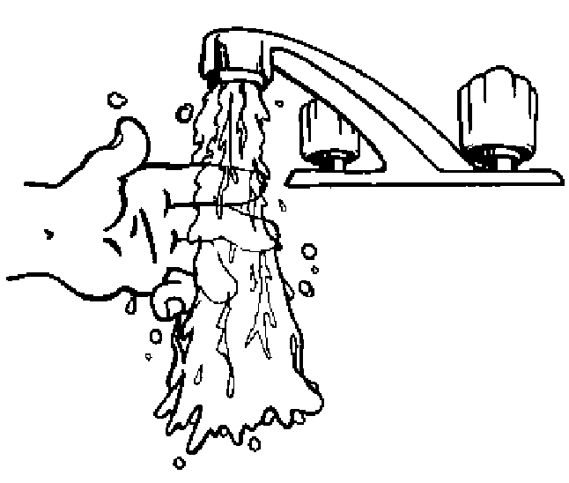
If You Get Burned
Cool the burned area with cool water for at least 10 minutes
Tell an adult right away
Seek medical treatment, if necessary
Never put butter or ice on your burn
Your parents (or the doctor) will give you something for the pain, if needed

Slide 26
If a Fire Starts in Your Kitchen (or Elsewhere in the House)
Warn others of the fire
Get out and stay out
Go to your meeting place outside
Call 9-1-1 once you are outside from a cell phone or a neighbors house

Slide 27
Remember - kitchen fires and injuries are preventable with good fire safety practices

Slide 28
Healthy Snacks

Slide 29
Veggies & Dip
Keep prepared veggies along with small containers of ranch dip for snack time.
Shopping List for Veggies & Dip
Baby carrots
Grape tomatoes or cherry tomatoes
Cucumbers
Broccoli
Cauliflower
Bell peppers
Sugar snap peas
Ranch dip

Slide 30
Fruit & Cheese Kabobs
The best part about fruit & cheese kabobs as a snack is that everything tastes better on a stick!
Prepare bowls of cut up pineapple, apple grapes and cheese cubes that can be threaded on a wooden kabob stick before they're eaten.
Shopping List
Pineapple
Strawberries
Apples
Grapes
Cheese cubes
Kabob sticks

Slide 31
Yogurt Parfaits
Instead of sugary kids' yogurt–which often contains high fructose corn syrup and is more expensive anyway–opt for the adult version made with real sugar (or better yet, choose plain yogurt and sweeten it with fruit!) In a high glass or tall dessert cup, alternate layers of yogurt, granola, cut up fruit or frozen berries. All make great additions to a parfait!
Shopping List
Yogurt
Your favorite fruit
Granola

Slide 32
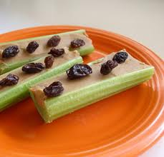
Ants on a Log
Celery sticks filled with peanut butter and topped with raisins are a classic snack. Think outside the box and top with craisins or other dried fruit.
Shopping List
Celery
Peanut Butter
Raisins

Slide 33
Cinnamon or Peanut Butter Toast
For a healthy snack, choose whole grain bread for your toasted treat. Top with peanut butter or butter and cinnamon sugar.
Shopping List
Whole grain bread
Peanut Butter
Cinnamon sugar

Slide 34
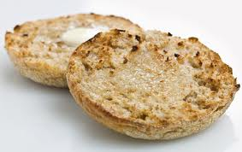
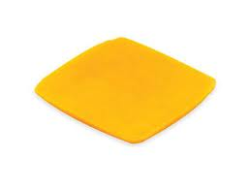
Toasted Cheese Sandwich
Start by toasting English muffins. Once done toasting, pull the halves out of the toaster right away and put a slice of cheese between them to make an easy "toasted cheese" sandwich.
(If necessary, heat in the microwave for 10 seconds to melt the cheese more.)
Shopping List
English muffins
Sliced cheese

Slide 35
Microwave Popcorn
Popcorn is a tasty, easy treat. Microwaves vary in power levels so ask your parent how many minutes you should cook the microwave popcorn. Remember, the bag will be HOT so be careful when you open it.
Shopping List
Microwave popcorn

Slide 36
Smoothies
Add ingredients and blend.
Shopping List for Banana Smoothie
2 bananas – cut up in chunks
1 cup milk
3-6 oz. of plain or vanilla yogurt
Shopping List for Strawberry-Orange Smoothie
2 cups orange juice
1 pkg. (16 oz.) frozen whole strawberries
1 pkg. (3.4 oz.) vanilla Flavor Instant Pudding

Slide 37
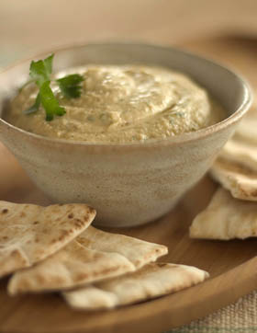
Hummus & Pita Bread
Cut pita bread into wedges. Dip in hummus and enjoy!
Super easy, healthy and tasty. Hummus is high in fiber, protein and iron. There are many flavors of hummus – get adventurous and try a few.
Shopping List
Pita bread
Hummus

Slide 38
Questions

Slide 39

Questions?
Notes:
You don’t need to use this slide.

Slide 40





brooklynpark.org
/brooklynparkmn
/user/brooklynparkmn
@brooklynpark
Notes:
You don’t need to use this slide.

